Slide 1

Week04 - Navigation with UIKit
In the AI Era(Swift + SwiftUI)
Instructor : Mr. Nem Sothea
nemsothea13@gmail.com

Slide 2
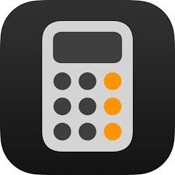
Overall Course Objective
By the end of this 3-hour session, students will be able to build a two-screen app that uses a navigation controller to display a list of items and navigate to a detail view, implementing both forward and backward data passing.

Slide 3
Path 1

Slide 4
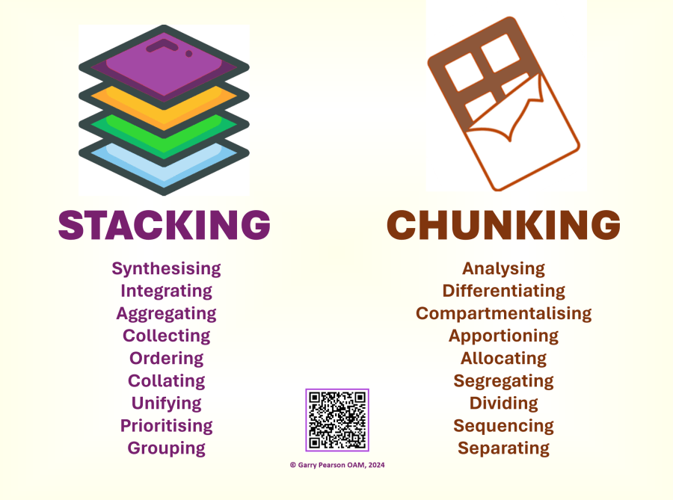
The Navigation Stack – UINavigationController
What is UINavigationController? Explain it as a "stack manager" for view controllers.
The Stack images: Use the relation of a stack of plates. You can only add (push) to the top or remove (pop) from the top.
Visual Components: Show the Navigation Bar (title, back button) and the UINavigationController provides it automatically.
Key Methods:
pushViewController(_:animated:) -> Adds a new screen to the stack.
popViewController(animated:) -> Removes the top screen from the stack.

Slide 5
Live Coding - Building the Foundation
Start a new name as "Single View App" Xcode project.
Delete the default ViewController.swift and its scene from Main.storyboard.
Create ItemListViewController (UITableViewController):
Drag a Table View Controller into the storyboard. Set it as the "Initial View Controller".
Create a new Cocoa Touch Class for it, subclassing UITableViewController.
In the storyboard, set the custom class of the Table View Controller.
In viewDidLoad(), give the navigation bar a title: title = "My Items".

Slide 6
Live Coding - Building the Foundation
Embed in Navigation Controller:
Select the Table View Controller in the storyboard.
Go to Editor > Embed In > Navigation Controller. Xcode will make the Navigation Controller the initial view controller.
Show students the navigation bar that now appears.
Create ItemDetailViewController (UIViewController):
Drag a standard View Controller into the storyboard.
Create a new Cocoa Touch Class for it, subclassing UIViewController.
Set the custom class in the storyboard.
Add a UILabel to the center of the view. This will later display the selected item.

Slide 7
**Hands-On Activity - Manual Push
Task: Create a button on the ItemListViewController that, when pressed, pushes the ItemDetailViewController onto the stack.
Steps:
Add a UIButton to the prototype cell in the ItemListViewController scene (or just use the default cell for now).
Create an @IBAction in ItemListViewController.swift.
Inside the IBAction, get a reference to the ItemDetailViewController from the storyboard using instantiateViewController(withIdentifier:). (You must set the Storyboard ID for the detail VC first!).
Use navigationController?.pushViewController(detailVC, animated: true).

Slide 8
Questions?
Next Week: Navigation - Moving between multiple screens!
Thank you!

